Slide 1

Demography of Sikkim
Sikkim, a small state nestled in the Himalayas, boasts a diverse and unique demography. Its populationA reflects the rich cultural tapestry of the region, blending influences from Tibet, Nepal, and Bhutan.

Slide 2
Geographic location and climate
Geographical Highlights
Sikkim is situated in the northeastern
part of India, bordered by Tibet, Nepal,
and Bhutan. It is known for its rugged,
mountainous terrain and diverse ecosystems.
Climatic Variations
The state experiences a varied climate, ranging
from subtropical in the south to alpine in the northern
regions. This diversity supports a rich array of flora
and fauna.

Slide 3

Population statistics and trends Population Growth Sikkim has experienced steady population growth in recent decades, driven by natural increase and migration from neighboring regions. Urbanization The state's urban population has been rapidly increasing, with more people moving to cities like Gangtok for economic and educational opportunities. Aging Population Sikkim, like many other parts of India, is witnessing a gradual aging of its population, posing challenges for social welfare and healthcare services.

Slide 4

Ethnic diversity and demographics
Lepcha
The indigenous Lepcha people are one of the main ethnic groups in Sikkim, known for their rich cultural heritage and close connection to the land.
Bhutia
The Bhutia community, with roots in Tibet, form a significant portion of Sikkim's population and have
played a crucial role in the state’s
history.
Nepali
A large Nepali-speaking
population, including Gorkhas,
Rais, Limbus, and others, has
settled in Sikkim, contributing to
its cultural mosaic.
Other Groups
Sikkim is also home to smaller
ethnic groups like the Limboos,
Tamangs, and Sherpas, all of
whom add to the state's rich
diversity.

Slide 5
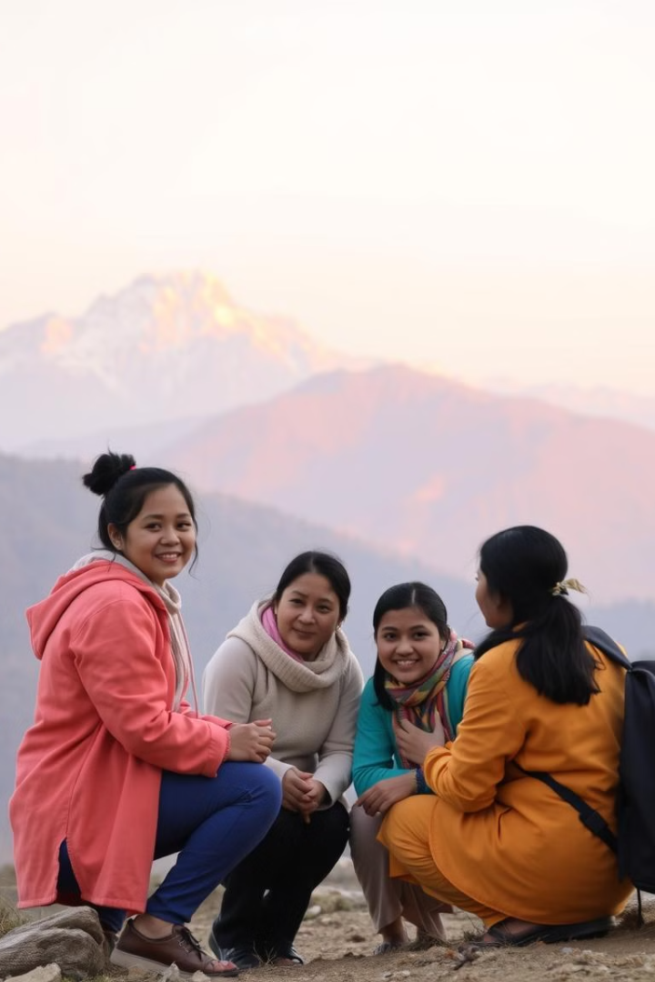



Challenges and opportunities
Environmental Challenges
Sikkim's fragile ecosystem faces threats from climate change, deforestation, and unsustainable development, requiring collaborative efforts to protect its natural resources.
Infrastructure Development
Improving transportation, communication, and healthcare infrastructure in the mountainous terrain is crucial for the state's economic and social progress.
Preserving Culture
Safeguarding the unique cultural traditions and heritage of Sikkim's diverse ethnic groups is a key priority, as the state navigates modernization.

